Slide 1


Solution By: MATRIX
PSID: INTL-NLP-11
Team Leader Name: Ashok K

Slide 2

Idea Introduction
IDEA TITLE- BASELINE
Tech Stack
1. Python
2.Visual Studio code
Resources Used
1. Flask
2. Python lib.
IDEA-OUTCOME – HEADLINE-
The outcome of abstractive model are that it rewrites the sentences from the important sentences. It also uses intermediate extractive model to improve the model's stability and quality

Slide 3


Your Approach Towards Idea
Approach
. It works on encoder and decoder method by using sequence to sequence model .It converts the input(in sequence) into vectors by using Glove
The model works how humans summarize a given document by using an extractor agent to get the important sentences and then uses an abstractor-encoder-aligner-decoder-model-network and then rephrases these extracted sentences.
Notes:
Use any image of your proposed solution here instead of this macbook image

Slide 4
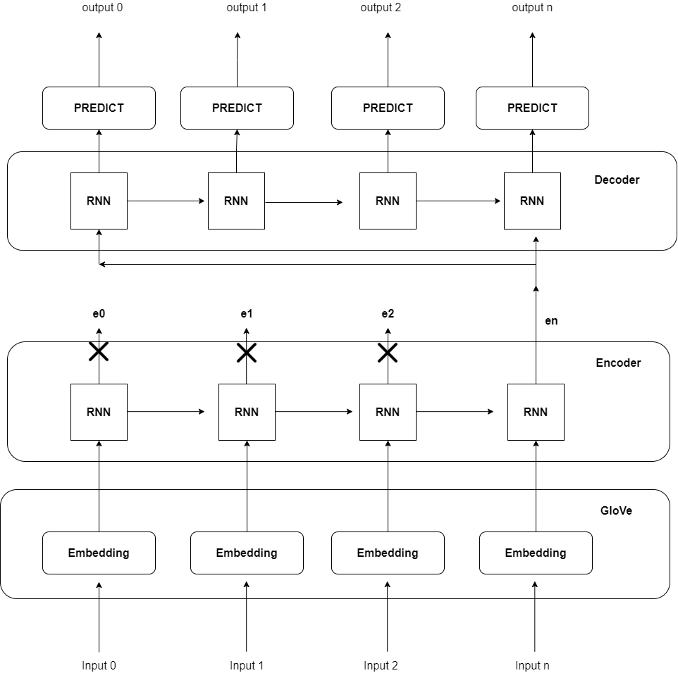
Development Pipeline

Slide 5

Team Slide
Ashok K
Sreeparvathy V S
Yogalakshmi R
Sowgenya R

Slide 6
Vision of Innovation/Idea/Solution
Easy to take important points from lengthy documents
The model works how humans summarize a given document by using an extractor agent to get the important sentences
Extractive Text summarization were implemented not Abstractive
For effective completion of project it takes upto 3 weeks

